Slide 1
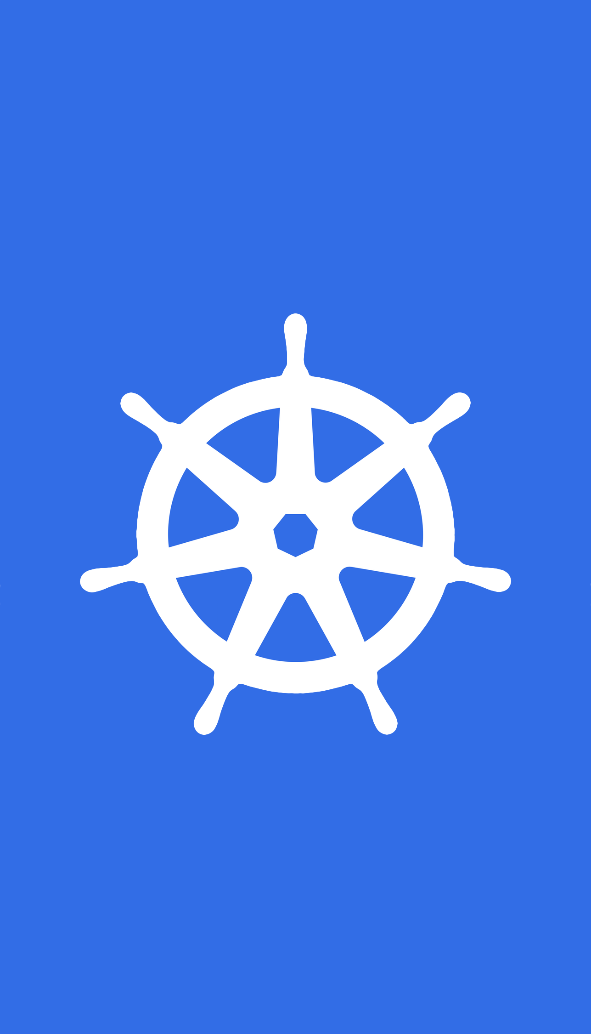
Container Orchestration with Kubernetes

Slide 2
Agenda
1. Containers and Container Orchestration
2. Need for Container Orchestration
3. Kubernetes and its Architecture
4. Kubernetes Objects (Core concepts)
5. Container orchestration with Kubernetes
6. Why Kubernetes(Advantages of Kubernetes)

Slide 3
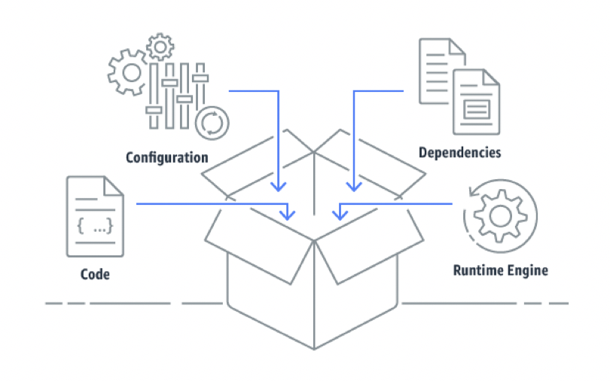
1. Containers
Containers are an executable unit of software in which application code is packaged, along with
its libraries and dependencies, in common ways so that it can be run anywhere, whether it be on
desktop, traditional IT, or the cloud
Containers share an operating system installed on the server and run as resource-isolated processes,
ensuring quick, reliable, and consistent deployments, regardless of environment.
container = image + isolation
Docker
Linux Container
Flux
Vagrant
Rancher

Slide 4
1. Container Orchestration
Container orchestration is all about managing the lifecycles of containers, especially in large, dynamic environments. Software teams use container orchestration to control and automate many tasks: Provisioning and deployment of containers. Redundancy and availability of containers.
Kubernetes
Docker Swarm
Apache Mesos (and Marathon)

Slide 5
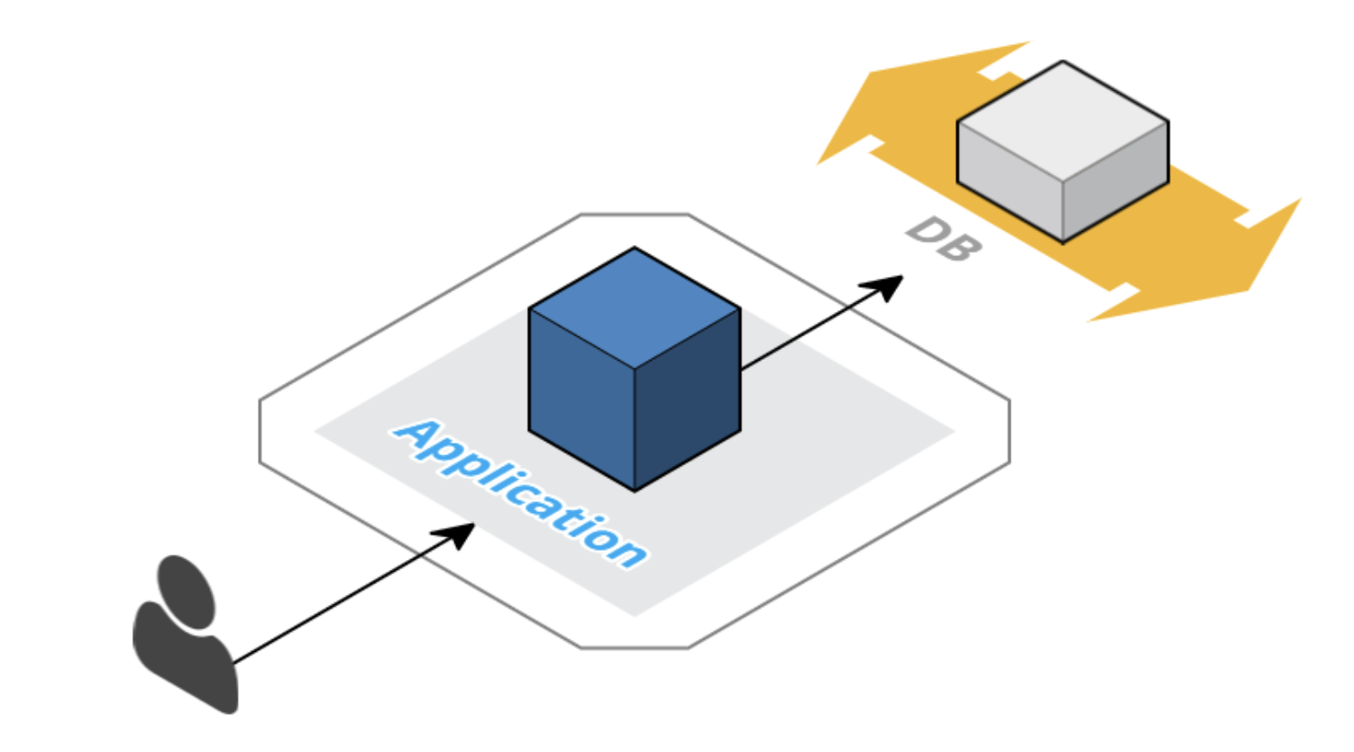
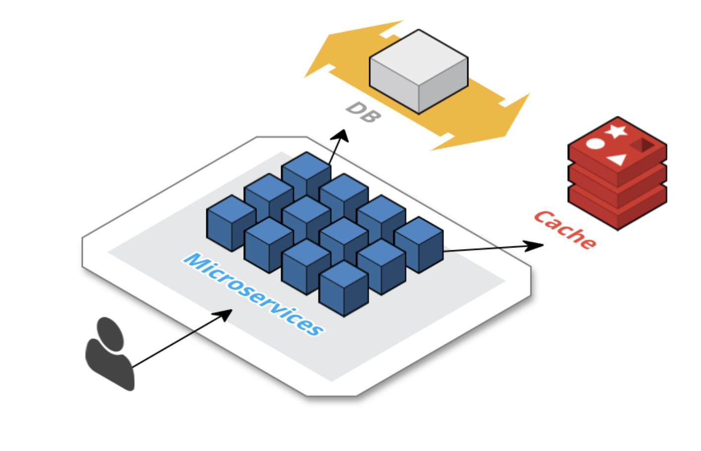
2. Need for Container Orchestration
• Switch from Monoliths to Microservices applications.
• Rapid release cycles.
• Respond to system load automatically.
• Deployments are at a much larger scale.
• Need to use resources efficiently.
• Providing consistent environment for applications
• DevOps culture
Containerized Microservices
Monolithic

Slide 6
What is Kubernetes ?
Kubernetes is an open-source container-orchestration system for automating application deployment, scaling, and management. It was originally designed by Google, and is now maintained by the Cloud Native Computing Foundation.
An infrastructure framework for today
Kubernetes, is by now the de facto standard for container management.

Slide 7
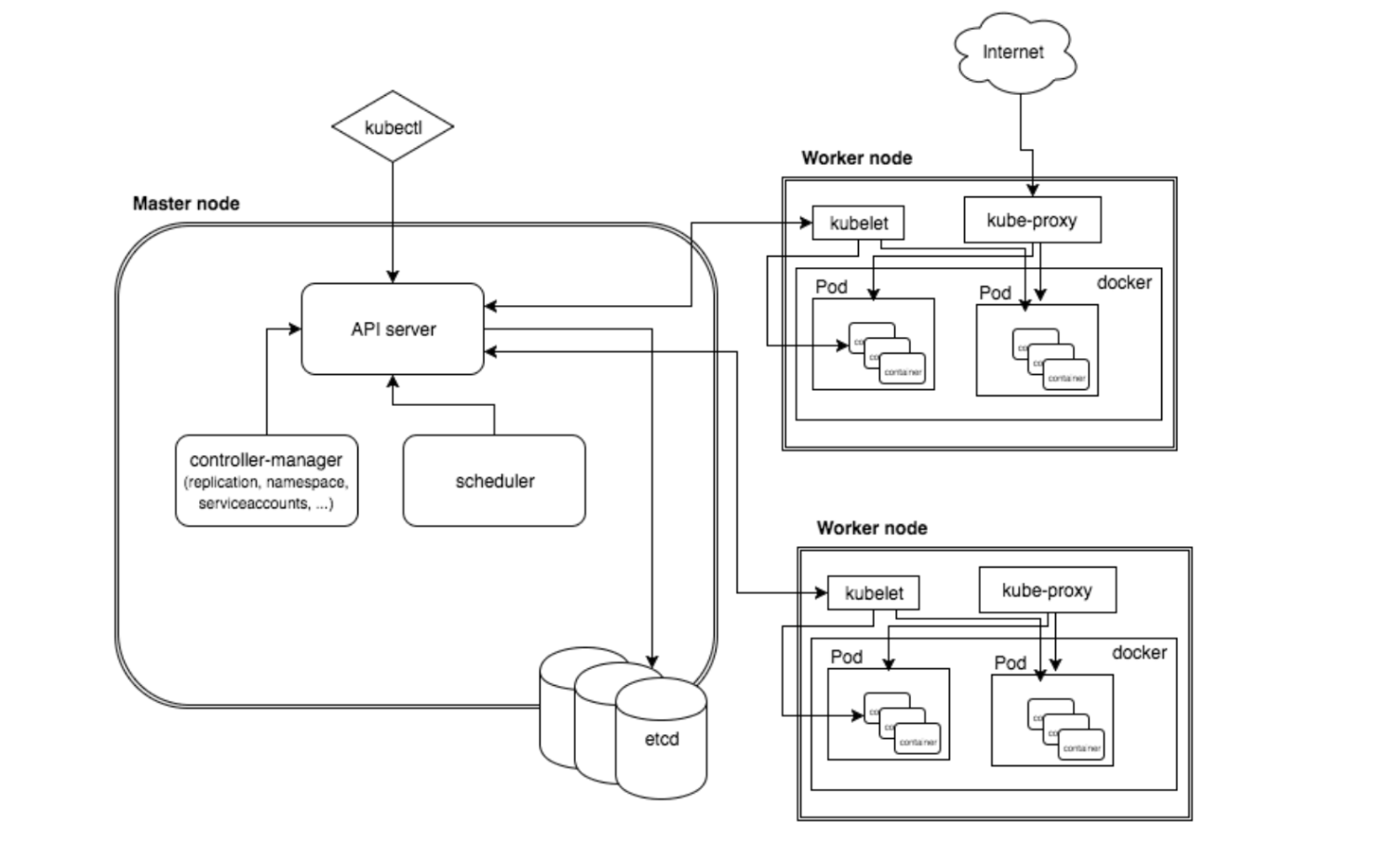
2. Kubernetes Architecture
Kubernetes follows a client-server architecture.
Master Components(Control Plane):
etcd: a simple, distributed key value storage which is used to store the Kubernetes cluster data.
(kube-)apiserver - Kubernetes API server is the central management entity that receives all REST requests for modifications (to pods, services, replication sets/controllers and others), serving as frontend to the cluster.
(kube-)controller-manager - runs a number of distinct controller processes in the background (for example, replication controller).
Always evaluating current vs desired state
cloud-controller-manager - is responsible for managing controller processes with dependencies on the underlying cloud provider (if applicable).
(kube-)scheduler - Schedules pods to worker nodes.

Slide 8
3. Kubernetes Architecture . . .Contd
Kubernetes follows a client-server architecture.
Worker node (control plane) components
kubelet - kubelet: Acts as a conduit between the API server and the node.
kube-proxy - Manages IP translation, routing and exposes services to the external world.

Slide 9
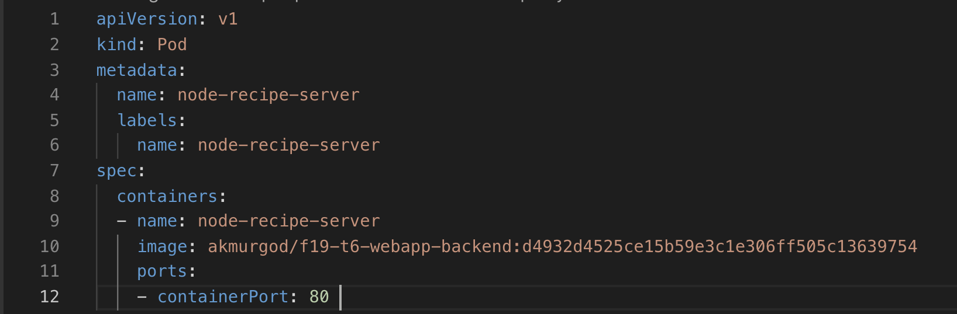
4. Kubernetes Objects(Core concepts)
Pod
A pod (basic unit in Kubernetes)is a group of one or more containers (such as Docker containers), with shared storage/network, and a specification for how to run the containers.

Slide 10
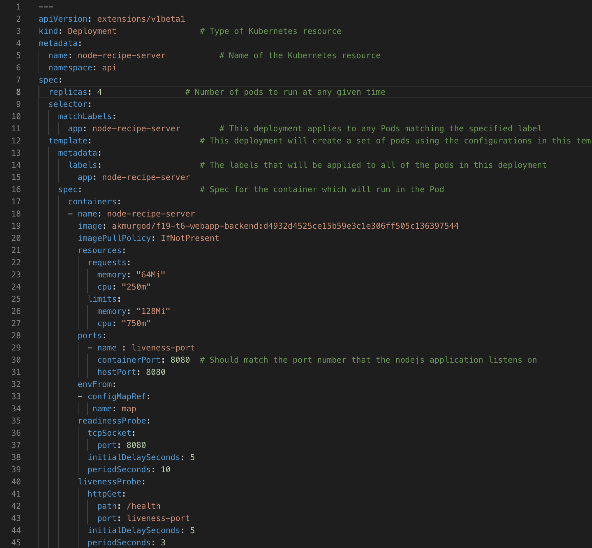
5. Kubernetes Objects(Core concepts)
Replica Set
A Replica Set Ensures a defined number of pods are always running.
Deployment
A Deployment A Deployment object include Pod(s) and Replica Set. It also help to update the resources when you deploy new version.

Slide 11
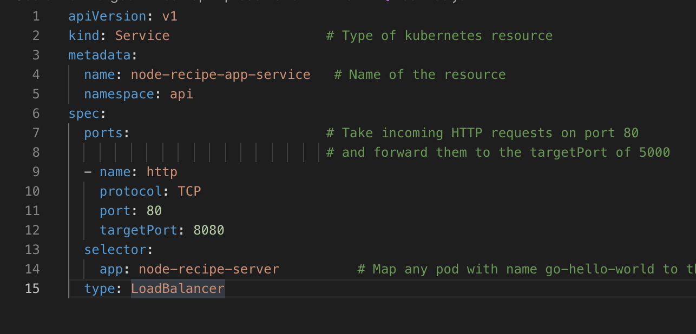
Kubernetes Objects(Core concepts)
Service
A service is object used to allow network access to a set of pods.
When running on Google Cloud Engine/AWS, Kubernetes can automatically configure a load balancer to access the application.

Slide 12
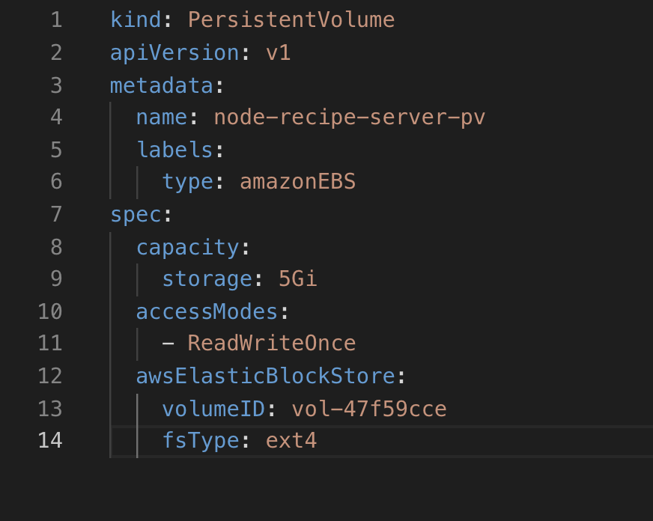
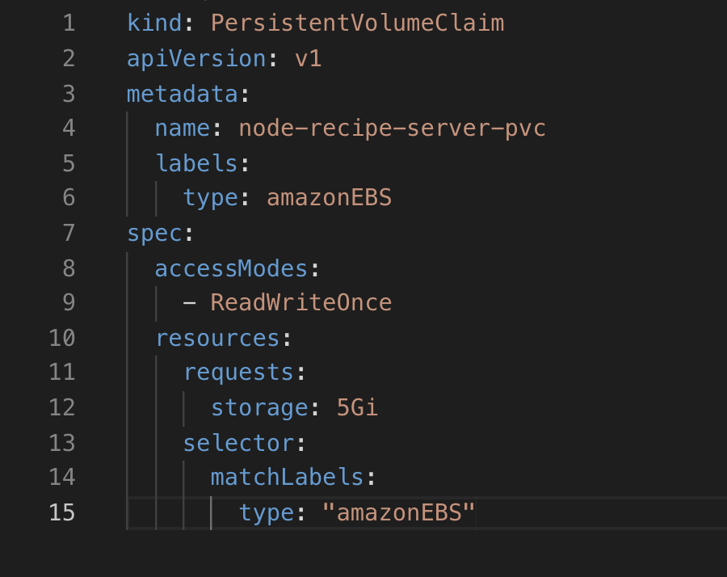
3. Kubernetes Objects . . . Contd
A PersistentVolume (PV) : is a piece of storage in the cluster that has been provisioned by an administrator or dynamically provisioned using Storage Classes. It is a resource in the cluster just like a node is a cluster resource. PVs are volume plugins like Volumes, but have a lifecycle independent of any individual Pod that uses the PV.
Persistent Volume Claim
A PersistentVolumeClaim (PVC) is a request for storage by a user. It is similar to a Pod. Pods consume node resources and PVCs consume PV resources. Claims can request specific size and access modes. (e.g., they can be mounted once read/write or many times read-only).
Pod can mount the Volume using Persistent Volume Claim object.

Slide 13
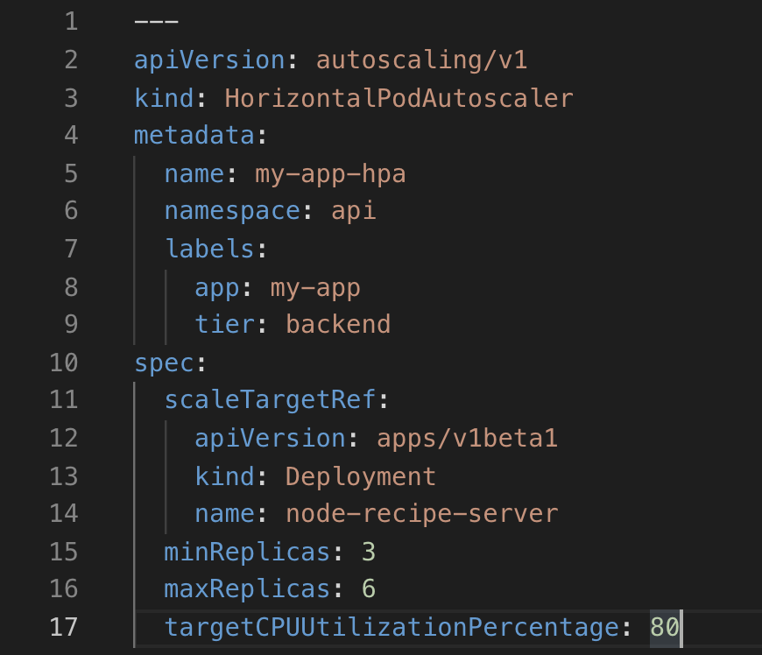
Kubernetes Objects(Core concepts)
Horizontal Pod Autoscaling:
Horizontal Pod Autoscaling automatically scales the number of pods in a replication controller, deployment or replica set based on observed CPU utilization (or, with alpha support, on some other, application-provided metrics).

Slide 14
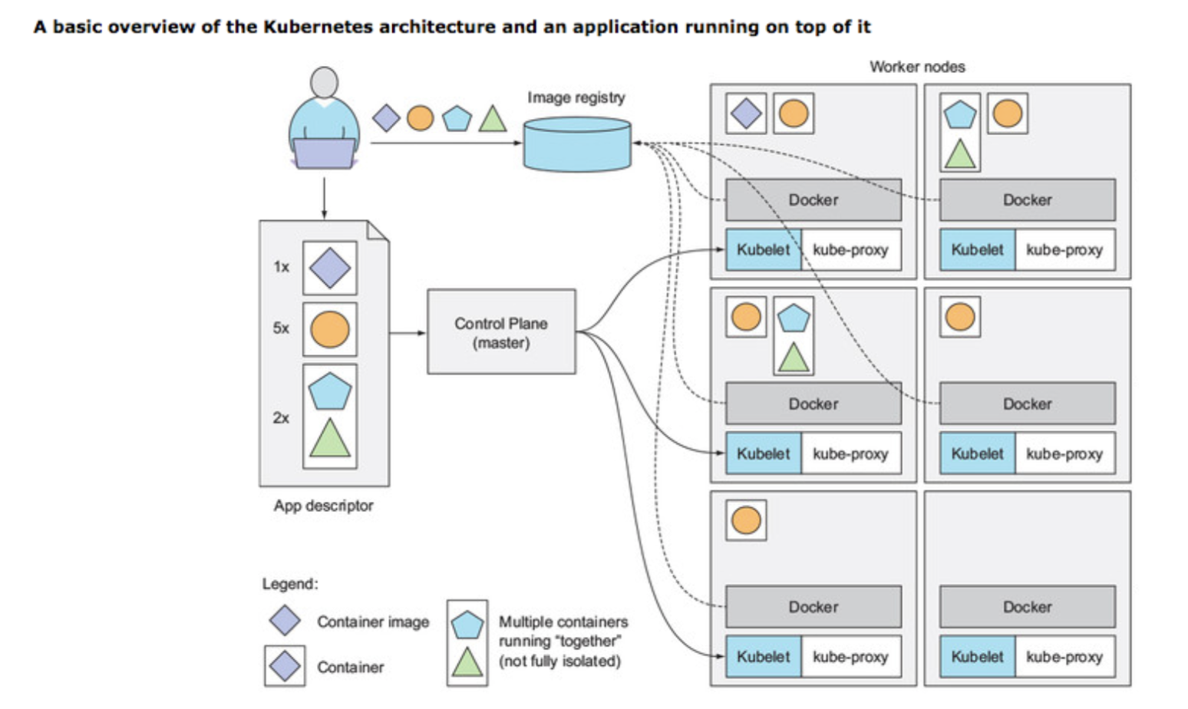
Container orchestration with Kubernetes
Diagram depicting container orchestration of 4 different containers
with different number of replica sets.

Slide 15
Simple deployment use case of Kubernetes on AWS

Slide 16
Why Kubernetes(Advantages of Using Kubernetes)
1. Declarative in Nature
Each set of instructions is rendered in human-readable YAML declaration or in Helm charts, which results in further benefits: Version control of your infrastructure.
2. Portable, Cloud Agnostic(Hybrid cloud strategy) Codebase
Kubernetes can run on virtually any public cloud, on-premise hardware, raspberry-pi or even bare metal. Developing applications for Kubernetes means that code can be redeployed multiple times, allowing you to select the infrastructure of your choosing.
3. Open source and cost effective
Kubernetes is open source, you can fork the stable repository version and develop new features on top it.
Public cloud vendors provide managed Kubernetes service to manage your infrastructure at additional cost.
EKS(Elastic Kubernetes Service): Kubernetes managed service by AWS
4. Optimized Resource Usage.
Kubernetes determines which Worker Nodes a container should run on based on available resources. By using Kubernetes you can rest assured that all of your compute resources are utilized efficiently across the cluster. As a result, you may be able to reduce the number of cloud instances or servers you operate, which can lead to cost savings.

Slide 17
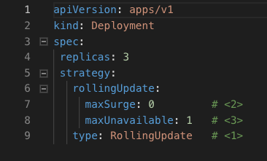
Why Kubernetes(Advantages of Using Kubernetes) contd…
5. Zero Downtime with Rolling Deployments
The ancestor: Blue-Green deployment:
When an update is required, you deploy it to the pre-production environment, test it, and switch the dispatcher so that pre-production becomes the new production environment, and vice versa
Kubernetes allows to do without Blue-Green deployment, by providing a dedicated Deployment object
and through rolling updates.

Slide 18
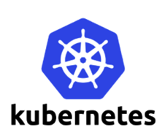

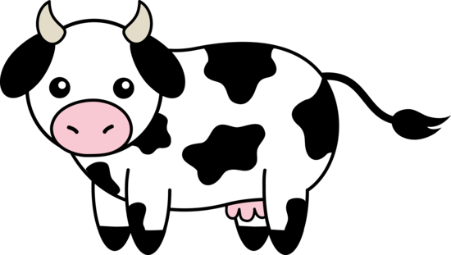
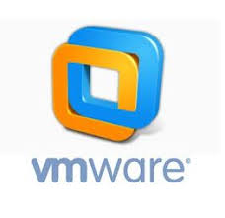
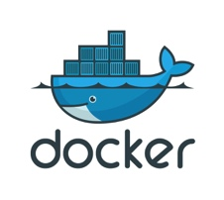
5. Kubernetes lets you handle your environment like a cattle.
pets vs cattle
- ephemeral
- brand them with #’s
- long lived
- name them
- care for them
6. Self-Healing :
For many reasons, containers can fail. Kubernetes keeps deployments healthy by restarting containers that have failed, killing and replacing unresponsive containers according to user-defined health checks, and re-creating containers that were on a failed backend Node across other available Nodes. This helps to mitigate what is a common pain point of the application upkeep process.

Slide 19
Why Kubernetes(Advantages of Using Kubernetes) contd…
6. Service Discoverability and Load balancing
It’s important that all services have a predictable way of communicating with one another. However, within Kubernetes, containers are created and destroyed many times over, so a particular service may not exist permanently at a particular location. This traditionally meant that some kind of service registry would need to be created or adapted to the application logic to keep track of each container’s location.
Kubernetes will provide IP addresses for each Pod, assign a DNS name for each set of Pods, and then load-balance the traffic to the Pods in a set. This creates an environment where the service discovery can be abstracted away from the container level.

Slide 20
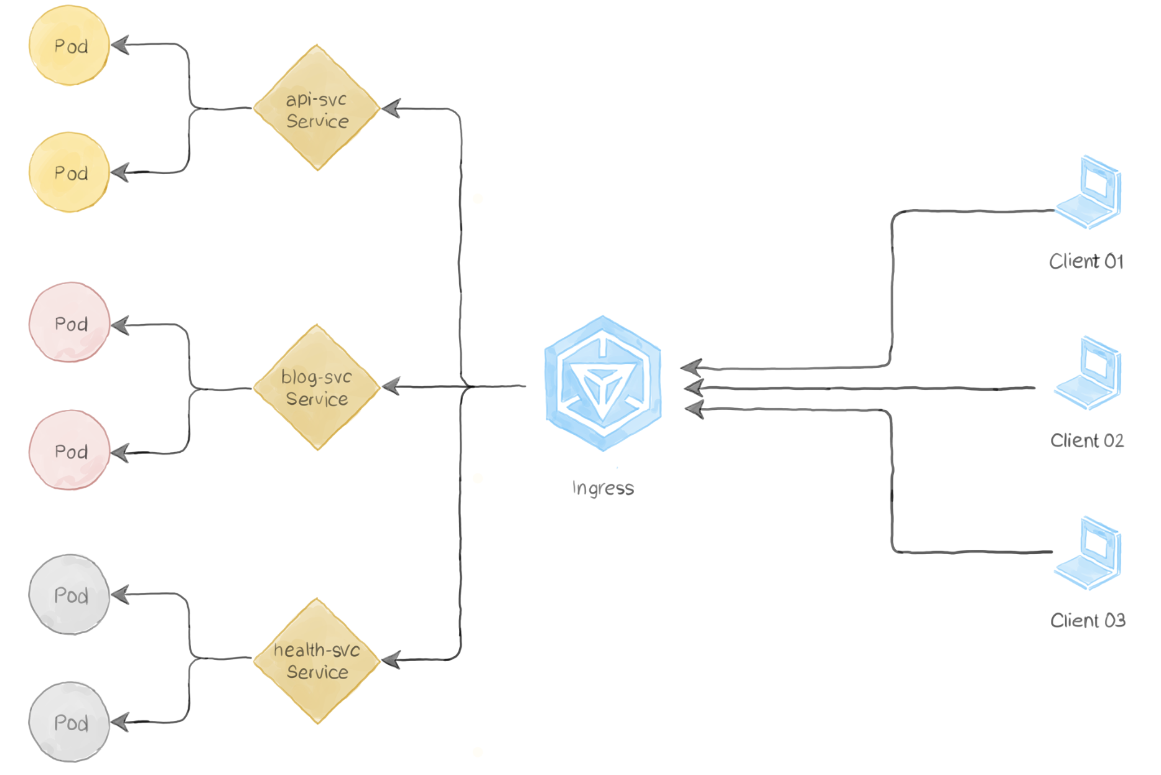
Why Kubernetes(Advantages of Using Kubernetes) contd…
7. Secrets Management
One of the hurdles in container creation is the inclusion of secrets, tokens, and passwords. You simply don’t want these sensitive values in your container images, especially if your containers are stored in a public registry like DockerHub. Kubernetes helps to alleviate this burden by providing Secrets objects, an etcd database-backed secrets management solution.
6. Declarative DNS Management
Ingress objects in Kubernetes allow for name based virtual hosting and HTTP routing in a straightforward, declarative manner.

Slide 21
Summary…
kubernetes is an open source system for automating deployment, scaling, and management of containerized applications.
Kubernetes has Server Client architecture running REST services developed in Go.
Kubernetes creates the resources using objects like Namespaces, Pods, Services, Deployments, Replica set.
Kubernetes has service discovery mechanism to handle networking between different applications on your infrastructure.
Kubernetes can be used on-premise, on public cloud and even on raspberry-pi.
Kubernetes can be used across multiple public clouds to Implement Hybrid Cloud Strategy.
Kubernetes provides Autoscaling thrugh Horizontal Pod Autoscaler and Cluster Auto Scaler objects.
Kubernetes provides Zero Downtime Deployment through Rolling updates.
Kubernetes declarations can be written in YAML definitions or as Helm Charts.

Slide 22
Q & A

Slide 23
Thank you.

